Slide 1



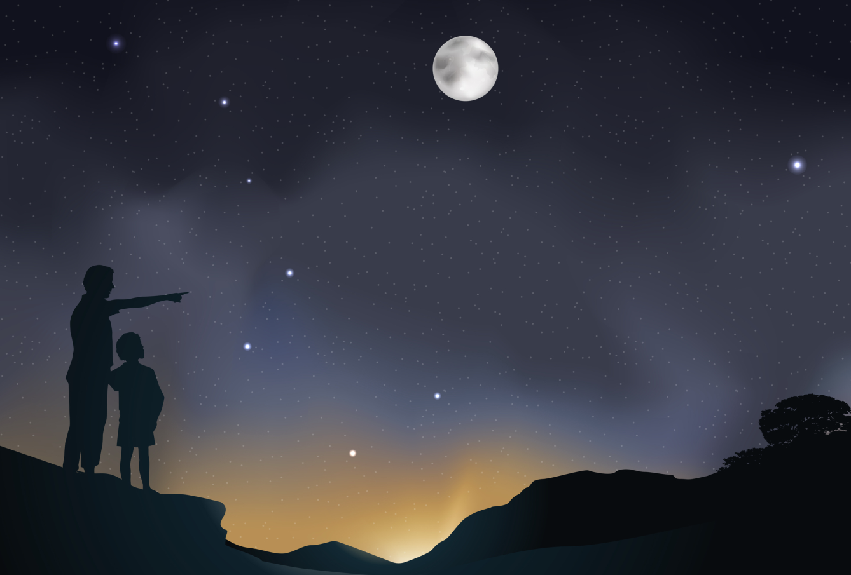
Text
The Glass Castle
About the author and the book
Go to the text

Slide 2

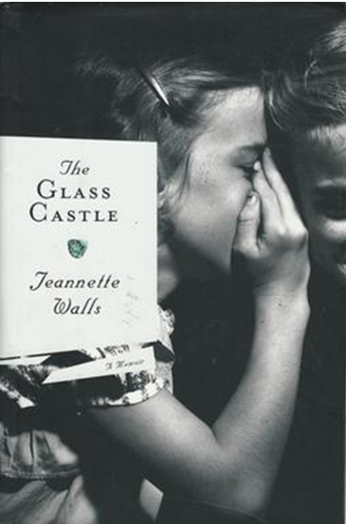
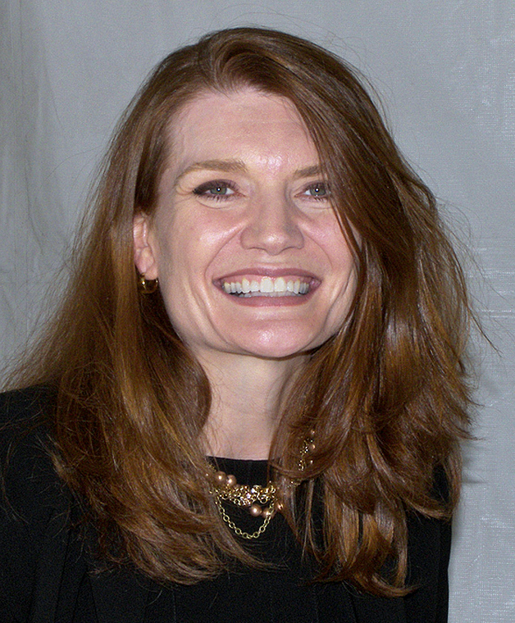

Text
Jeannette Walls is a successful editor, journalist, and writer. The book The Glass Castle is about the childhood of Jeannette Walls, her family, their lifestyle, and Walls’ career. It is very popular, a best-seller. The title of the book came from a promise that the writer’s father made. He said, by finding a lot of gold, he would build a glass castle for the family to live in.

Slide 3

Text
The Glass Castle
1 I never believed in Santa Claus.
2 None of us kids did. Mom and Dad refused to let us. They couldn’t afford expensive presents, and they didn’t want us to think we weren’t as good as other kids who, on Christmas morning, found all sorts of fancy toys under the tree that were supposedly left by Santa Claus. So they told us all about how other kids were deceived by their parents, how the toys the grown-ups claimed were made by little elves wearing bell caps in their workshop at the North Pole actually had labels on them saying MADE IN JAPAN.

Slide 4
Text
3 “Try not to look down on those other children,” Mom said. “It’s not their fault that they’ve been brainwashed into believing silly myths.”
4 We celebrated Christmas, but usually about a week after December 25, when you could find perfectly good bows and wrapping paper that people had thrown away and Christmas trees discarded on the roadside that still had most of their needles and even some silver tinsel hanging on them. Mom and Dad would give us a bag of marbles or a doll or a slingshot that had been marked way down in an after-Christmas sale.

Slide 5

Text
5 Dad lost his job at the gypsum mine after getting in an argument with the foreman, and when Christmas came that year, we had no money at all. On Christmas Eve, Dad took each of us kids out into the desert night one by one. I had a blanket wrapped around me, and when it was my turn, I offered to share it with Dad, but he said no thanks. The cold never bothered him. I was five that year and I sat next to Dad and we looked up at the sky. Dad loved to talk about the stars.

Slide 6
Text
He explained to us how they rotated through the night sky as the earth turned. He taught us to identify the constellations and how to navigate by the North Star. Those shining stars, he liked to point out, were one of the special treats for people like us who lived out in the wilderness. Rich city folks, he’d say, lived in fancy apartments, but their air was so polluted they couldn’t even see the stars. We’d have to be out of our minds to want to trade places with any of them.

Slide 7
Text
6 “Pick out your favorite star,” Dad said that night. He told me I could have it for keeps. He said it was my Christmas present. “You can’t give me a star!” I said. “No one owns the stars.” “That’s right,” Dad said. “No one else owns them. You just have to claim it before anyone else does, like that dago fellow Columbus claimed America for Queen Isabella. Claiming a star as your own has every bit as much logic to it.”
7 I thought about it and realized Dad was right. He was always figuring out things like that.

Slide 8
Text
8 I could have any star I wanted, Dad said, except Betelgeuse and Rigel, because Lori and Brian had already laid claim to them.
9 I looked up to the stars and tried to figure out which was the best one. You could see hundreds, maybe thousands or even millions, twinkling in the clear desert sky. The longer you looked and the more your eyes adjusted to the dark, the more stars you’d see, layer after layer of them gradually becoming visible. There was one in particular, in the west above the mountains but low in the sky, that shone more brightly than all the rest.

Slide 9
Text
10 “I want that one,” I said.
11 Dad grinned. “That’s Venus,” he said. Venus was only a planet, he went on, and pretty dinky compared to real stars. She looked bigger and brighter because she was much closer than the stars. Poor old Venus didn’t even make her own light, Dad said. She shone only from reflected light. He explained to me that planets glowed because reflected light was constant, and stars twinkled because their light pulsed.

Slide 10
Text
12 “I like it anyway,” I said. I had admired Venus even before that Christmas. You could see it in the early evening, glowing on the western horizon, and if you got up early, you could still see it in the morning, after all the stars had disappeared.
13 “What the hell,” Dad said. “It’s Christmas. You can have a planet if you want.”
14 And he gave me Venus.

Slide 11
Text
15 That evening over Christmas dinner, we all discussed outer space. Dad explained light years and black holes and quasars and told us about the special qualities of Betelgeuse, Rigel and Venus. Betelgeuse was a red star in the shoulder of the constellation Orion. It was one of the largest stars you could see in the sky, hundreds of times bigger than the sun. It had burned brightly for millions of years and would soon become a supernova and burn out.

Slide 12
Text
I got upset that Lori had chosen a clunker of a star, but Dad explained that “soon” meant hundreds of thousands of years when you were talking about stars.
16 Rigel was a blue star, smaller than Betelgeuse, Dad said, but even brighter. It was also in Orion — it was his left foot, which seemed appropriate, because Brian was an extra-fast runner.

Slide 13
Text
17 Venus didn’t have any moons or satellites or even a magnetic field, but it did have an atmosphere sort of similar to Earth’s, except it was super-hot — about five hundred degrees or more. “So,” Dad said, “when the sun starts to burn out and Earth turns cold, everyone here might want to move to Venus to get warm. And they’ll have to get permission from your descendants first.”

Slide 14
Text
18 We laughed about all the kids who believed in the Santa myth and got nothing for Christmas but a bunch of cheap plastic toys. “Years from now, when all the junk they got is broken and long forgotten,” Dad said, “you’ll still have your stars.”
■

Slide 15

Text
玻 璃 城 堡
1 我从来不相信有圣诞老人。
2 我们家的小孩没一个人信，妈妈爸爸不让我们相信。他们买不起昂贵的礼物，也不想让我们觉得我们比不上别的孩子——在圣诞节的早上，别的孩子都能在圣诞树下找到据说是圣诞老人放在那儿的各种新奇玩具。所以，爸爸妈妈跟我们说那些孩子怎样被他们的父母骗了，说那些大人们所说的由戴着有铃铛的帽子的小精灵在他们的北极工厂里制作的玩具其实标签上都写着“日本制造”。

Slide 16
Text
3 “尽量不要看不起那些小孩，”妈妈跟我们说，“他们之所以相信这些荒唐的神话是因为他们被洗脑了，这不是他们的错”。
4 我们也庆祝圣诞，但总是比12月25日要晚一个星期左右，因为到那时我们能找来被扔掉的完好无损的蝴蝶结和包装纸，以及被遗弃在路旁、针叶基本完好的圣诞树，树上有时甚至还悬挂着一些银色金属箔装饰物。爸爸妈妈会送给我们一袋弹珠、一个洋娃娃或一个弹弓，那是在圣诞节后商品大减价时买来的。

Slide 17
Text
5 爸爸跟石膏矿的工头发生了争执，然后就丢了工作。当那年的圣诞节到来时，我们穷得身无分文。圣诞夜，爸爸把我们小孩子挨个带到荒野的夜幕中。我当时身上裹着一条毛毯，在轮到我时，我要把毯子分给爸爸一些，但他说不用，谢谢。他从来不怕冷。那年我五岁，我挨着爸爸坐下，我们一起抬头看天空。他喜欢聊星星，

Slide 18
Text
他向我们讲解星星是怎样在地球自转时在夜空中转动的，他教我们辨认星座，教我们如何根据北极星的方位来导航。他喜欢强调一点，那些闪烁的星星是对像我们这样住在荒野上的人的特别款待。他会说，有钱的城里人虽然住在高档公寓里，但因为那里空气污染严重，他们甚至看不到星星。如果我们想跟他们中的任何一个交换住处，那我们一定是疯了。

Slide 19
Text
6 那天晚上，爸爸对我说：“选一个自己最喜欢的星星吧。”他说我可以一直拥有那颗星，那就是我的圣诞礼物。我说：“你不能给我一颗星星！没有人拥有星星。”父亲说：“对，别人没有拥有星星，你只要在别人之前说那颗星星属于你就行，就像拉丁佬哥伦布声称美洲属于伊莎贝拉女王那样。宣称一颗星星属于你的逻辑比起哥伦布的逻辑丝毫不差。”
7 我琢磨了一下爸爸的话，觉得他说的有道理。他总是以那种方法来思考问题。

Slide 20
Text
8 爸爸说，我可以要我想要的任何一颗星星，除了参宿四和参宿七（猎户座的两颗星星），因为这两颗星星洛丽和布赖恩已经认领了。
9 我仰望夜空中的繁星，想找出最好的那一颗。在荒野的夜空中，有成百、成千甚至上万颗星星在闪烁。看的时间越久，你的眼睛就越适应黑夜，你就可以看见更多的星星。一层又一层的，渐渐地变得越来越清晰可见。其中有一颗很特别，它在山的西面，但处于低空，比任何一颗星星都耀眼。

Slide 21
Text
10 “我要那颗，”我说。
11 爸爸笑了，“那是金星，”他说。金星只是一颗行星，他接着讲，与真正的恒星相比她非常小。她看上去更大、更亮是因为她比其他星星离我们近得多。爸爸说，可怜的金星甚至不能自己发光，她发出的光是反射光。他跟我解释说行星之所以发出稳定的光，是因为反射光是恒定光；恒星闪烁，是因为它们的光是脉冲光。

Slide 22
Text
12 “无论如何，我就喜欢这颗星，”我说。早在那个圣诞节之前我就喜欢金星了。在傍晚时分，你就能看见它照耀在西方的地平线上，如果你起得早，你会看见，所有的星星都消失了，唯独她还在。
13 “没关系，”爸爸说，“这是圣诞节，如果你只想要一颗行星，你就要好了。”
14 于是，他把金星给了我。

Slide 23
Text
15 那天晚上吃圣诞晚餐时，我们一起谈论了外太空。爸爸向我们讲解了光年、黑洞、类星体，并告诉了我们参宿四、参宿七以及金星的特征。参宿四是猎户座猎人肩上的一颗红色的星星。它是天空中肉眼能看到的最大的星星之一，比太阳还要大几百倍。它已经熊熊燃烧了几百万年，很快就要变成超新星，燃尽熄灭。

Slide 24
Text
我为洛丽挑了一颗破旧的老星而感到难过，但爸爸解释说，就星星而言，“很快”意味着几十万年之后。
16 参宿七是一颗蓝色的星星，比参宿四小，爸爸说，但比它亮，同属猎户座，在猎人的左脚上。这颗星看起来很适合布赖恩，因为他跑得超快。

Slide 25
Text
17 金星没有像月亮那样的卫星或其他卫星，甚至没有磁场，但它有类似于地球的大气层，但金星的大气层超级热，温度大约高达五百度或更高。“所以，”爸爸说，“当太阳即将燃尽，地球变冷的时候，地球上的每一个人可能都想搬到金星上取暖。这样的话，他们首先要获得你们子孙的同意才行。”

Slide 26
Text
18 我们嘲笑那些相信圣诞童话的小孩，他们除了一堆廉价的塑料玩具外什么也没有得到。“再过些年，他们得到的那些垃圾玩具都坏了，早就被他们遗忘了，”爸爸说，“你们的星星却依旧在空中闪耀。”

Slide 27

Exercises
Reading and understanding
Dealing with unfamiliar words
Reading and interpreting
Developing critical thinking

Slide 28
Exercises
Reading and understanding
3 Answer the questions.
4 Choose the best summary of the passage.

Slide 29
Exercises
3 Answer the questions.
1 Why did the parents generally refuse to give their children Christmas presents?
2 In what way did other parents deceive their children?
3 Why did they celebrate Christmas about a week later?
4 How many children went with their father each time?
5 Why did they go to the desert to see the stars?
6 Who do the stars belong to, according to the writer’s father?
7 In what way is Venus different from Betelgeuse and Rigel?
8 What advantages did the stars have over traditional Christmas presents?

Slide 30
Exercises
1
The parents couldn’t afford to give the children expensive presents, so they would buy presents after Christmas at a reduced price.
2 In what way did other parents deceive their children?
Other children’s parents told them that their presents were left by Santa Claus and made in the North Pole. In fact, the presents were made in Japan and left by the parents.
Why did the parents generally refuse to give their children Christmas presents?

Slide 31
Exercises
3 Why did they celebrate Christmas about a week later?
They celebrated Christmas about a week later, because at that time they could get Christmas trees, wrapping paper, decorations, and presents more cheaply, or even for free.
4 How many children went with their father each time?
One child went into the desert with the father each time.
5 Why did they go to the desert to see the stars?
They went to see the stars because the father wanted to “give” each child a star or planet. He said that these were their Christmas presents.

Slide 32
Exercises
6 Who do the stars belong to, according to the writer’s father?
According to the father, the stars didn’t belong to anyone, so they could be claimed by the children.
7 In what way is Venus different from Betelgeuse and Rigel?
Betelgeuse and Rigel are stars, while Venus is a planet, not a star. Venus is smaller than a star and doesn’t make its own light.
8 What advantages did the stars have over traditional Christmas presents?
The stars last much longer than toys. The father says that when the toys are all broken and forgotten, the stars will still exist.

Slide 33
Exercises
4 Choose the best summary of the passage.
1 The writer’s father shows his children the real meaning of Christmas by celebrating it a week later.
2 The writer’s family was so poor that they couldn’t afford presents for each other at Christmas.
3 The father showed imagination in allowing the children to choose stars as Christmas presents, instead of cheap toys.

Slide 34
Exercises
Dealing with unfamiliar words
5 Complete the paragraph with the correct form of the words below.
6 Replace the underlined words with the correct form of the words below.
7 Answer the questions about the following words and expressions.

Slide 35
Exercises
5 Complete the paragraph with the correct form of the words below.
deceive descendant horizon
layer magnetic twinkle
What can you see in the night sky? First, look for what appears to be the brightest object. Does it (1) __________ or does it glow? If it glows, it’s probably a planet. If not, it’s probably a star. Most nights the brightest object is the planet of Venus. Look towards the (2) __________ and then look up directly above you, and then back again. But don’t allow Venus to (3)__________ you.
twinkle
horizon
deceive

Slide 36
Exercises
deceive descendant horizon
layer magnetic twinkle
In comparison with the stars, it’s bright because it’s close. The glow from the (4)_________ of stars in the rest of the sky comes from many light years away. The light emitted as you gaze at the stars will only be seen by your (5) ____________many years in the future. Finally, look towards the north to see the North Star. This is of course outside the Earth’s (6)________ field, so it’s what we call “true north”.
layer
descendants
magnetic

Slide 37
Exercises
6 Replace the underlined words with the correct form of the words below.
junk label logic marble myth
1 One of the cheapest presents you can get for children is a bag of small coloured glass balls.
2 Most people keep too much rubbish in their garage and should throw something out.
3 The tag on the sweater says large, but it feels quite tight.
4 Many of the stories about how the universe was formed are purely fictional.
5 It’s certainly reasonable not to believe in Santa Claus, but the Christmas story is full of irrational events.
marbles
junk
label
mythical
logical

Slide 38
Exercises
7 Answer the questions about the following words and expressions.
1 Is an elf likely to be (a) a real-life workman, or (b) a small imaginary person with special powers?
2 When someone has been brainwashed, have they (a) been forced to believe or do something, or (b) chosen their own beliefs or course of action?
3 Is a foreman likely to be (a) a worker, or (b) a man in charge of workers?
7 Answer the questions about the following words and expressions.
1 Is an elf likely to be (a) a real-life workman, or (b) a small imaginary person with special powers?
2 When someone has been brainwashed, have they (a) been forced to believe or do something, or (b) chosen their own beliefs or course of action?
3 Is a foreman likely to be (a) a worker, or (b) a man in charge of workers?

Slide 39
Exercises
4 Is a constellation (a) a single star, or (b) a group of stars?
5 When someone navigates their way across the world, are they (a) following a route on a map or with instruments, or (b) travelling without knowing where they’re going?
6 Does for keeps mean (a) for ever, or (b) for a while?
7 Is a dinky planet likely to be (a) fairly small, or (b) extremely big when compared with real stars?
4 Is a constellation (a) a single star, or (b) a group of stars?
5 When someone navigates their way across the world, are they (a) following a route on a map or with instruments, or (b) travelling without knowing where they’re going?
6 Does for keeps mean (a) for ever, or (b) for a while?
7 Is a dinky planet likely to be (a) fairly small, or (b) extremely big when compared with real stars?

Slide 40
Exercises
Reading and interpreting
8 Work in pairs. Look at the sentences from the passage and answer the questions.
1 They couldn’t afford expensive presents, and they didn’t want us to think we weren’t as good as other kids … “Try not to look down on those other children,” Mom said.
What might other kids think of the writer’s family who had no expensive presents? How did the writer’s parents protect their own children?
Other kids might look down on the writer’s family for being poor and not having expensive presents. The writer’s parents protect their children by telling them they are luckier than other kids. For example, they have stars while other kids just have “junk”.

Slide 41
Exercises
2 The cold never bothered him.
What does this suggest about the father?
This suggests that he was used to hardships and being cold, perhaps because he spent a lot of time outside. It also suggests that he had a strong personality.

Slide 42
Exercises
3 Those shining stars, he liked to point out, were one of the special treats for people like us who lived out in the wilderness.
How might city dwellers see people who live in the wilderness? How did the father make living in there a special treat?
City dwellers might see people who live in the wilderness as unlucky, uncultured or of a lower class. The father made living there a special treat by showing his children the natural wonders of the place. He also taught his children about the natural world and used reasoning to give them perspective.

Slide 43
Exercises
4 Claiming a star as your own has every bit as much logic to it.
What is the father’s reasoning for claiming a star? Does the logic make sense to you?
The father says that no one currently owns the stars, so to own one you have to be the first person to claim it. The logic doesn’t make sense to me, because the stars are too far away to visit or to be useful.

Slide 44
Exercises
5 Poor old Venus didn’t even make her own light, Dad said.
Does the father see this as a positive or negative quality of Venus?
Would he prefer his children to be stars or planets?
The father sees this as a negative quality of Venus. I think he would prefer his children to be stars rather than planets, being interesting themselves rather than reflecting other people’s greatness.

Slide 45
Exercises
6 “It’s Christmas. You can have a planet if you want.”
What does this suggest about her father’s sense of authority or sense of humour?
It suggests that he has a strong sense of humour and a lack of respect for authority.

Slide 46
Exercises
That evening over Christmas dinner, we all discussed outer space.
7
Does the writer sound surprised by the subject of conversation?
What would people usually talk about over Christmas dinner?
No, the writer doesn’t sound surprised by the subject. Perhaps it’s normal for her family to talk about such serious subjects. People would usually talk about Christmas-related subjects or family news over Christmas dinner.

Slide 47
Exercises
8 “Years from now, when all the junk they got is broken and long forgotten,” Dad said, “you’ll still have your stars.”
What kind of future did the father hope his children would have?
The father hoped that his children would be happy in the future, and that they will continue to be inspired by the stars and other things that he taught them. He doesn’t want them to have typical lives.

Slide 48
Exercises
Developing critical thinking
9 Work in pairs and discuss the questions.
1 What does the passage imply about wealth? Do you agree with the implication?
2 What are the moral qualities of the stars and planets which we can infer from the passage?
3 Should we always reject myths and only rely on logic?

Slide 49
Exercises
1 What does the passage imply about wealth? Do you agree with the implication?
The passage implies that we don’t need to be rich to be happy or to lead full, interesting lives. I agree with this implication, as it is love, friends, and new experiences that are important.
It implies that wealth doesn’t make us happy. That may be partly true, but I think wealth certainly makes it easier to be happy. You can’t be happy if you’re worried about money.

Slide 50
Exercises
2 What are the moral qualities of the stars and planets which we can infer from the passage?
The writer seems to say that stars are superior to planets because they make their own light, while planets only reflect the light of stars. We can infer that stars are more interesting and original than planets, much as some people have more interesting characters than other people.

Slide 51
Exercises
3 Should we always reject myths and only rely on logic?
We should try to be logical and scientific in our thinking. It’s fine for children to believe in myths, but as adults we have to live in the real world.
Myths and creative thinking are very important and we shouldn’t ignore them. Almost all art and religion relies on myths and fantasy. If we block these from our minds, our lives will be less exciting.

